Slide 1

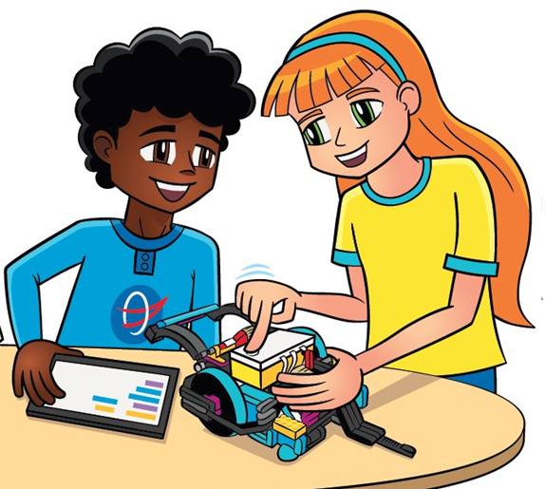
Session 1

Slide 2
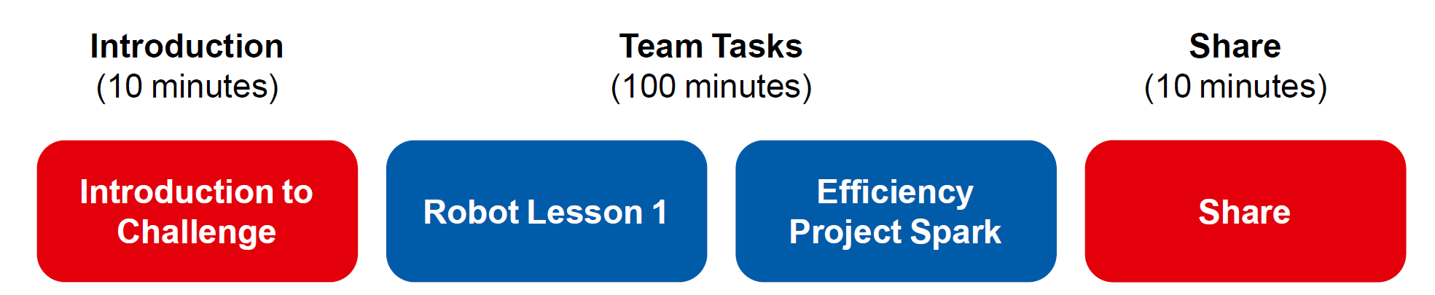
Session Overview
Outcomes
The team will learn how to connect and use the sensors and motors.
The team will make connections from the mission models to the Efficiency Project Spark ideas.
Notes:
Facilitator Tips
Each session in this guide is two hours. If needed, split each session into two separate 60-minute meetings by having the team complete each page in a 60-minute meeting.

Slide 3
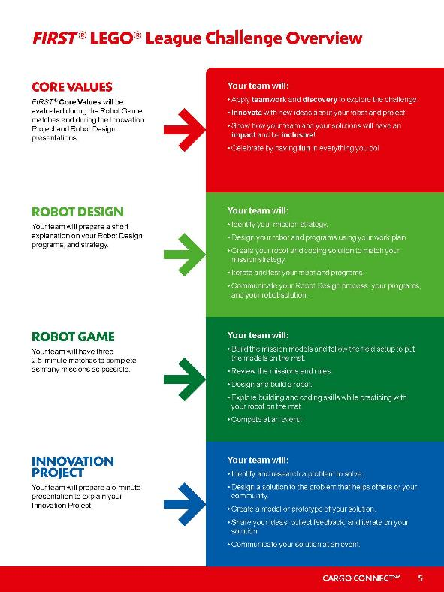
Introduction
Read pages 4-9 explaining how FIRST® LEGO® League Challenge works.
Now that you have read about CARGO CONNECTSM, you are ready to get started.

Slide 4

CARGO CONNECTSM
Visit the
FIRST® LEGO ® League
YouTube Channel
to watch the
CARGO CONNECT season launch video
Notes:
Facilitator Tips
Share the season videos on the FIRST® LEGO® League YouTube Channel with the team.
If you have already watched the season launch video in the introductory slides, you may choose to skip it here.

Slide 5
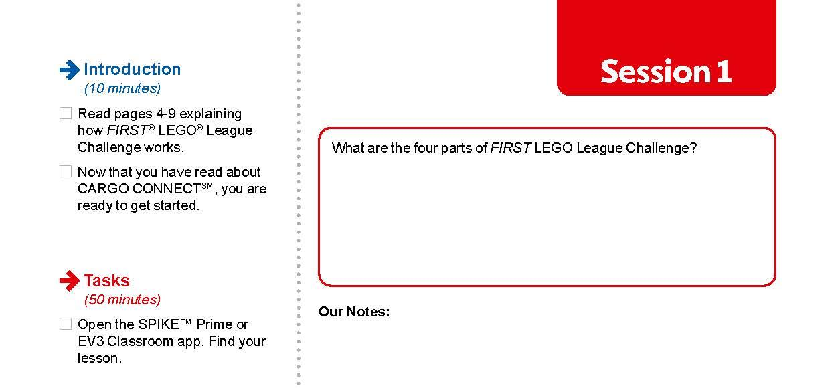
Introduction
Take notes in your Engineering Notebook.
Notes:
Facilitator Tips
Every session has an Introduction prompt and space to document the team’s responses.

Slide 6
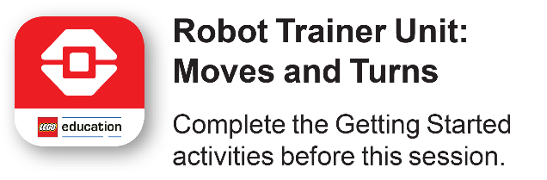

Robot Lesson 1
Open the SPIKE™ Prime or EV3 Classroom app. Find your lesson.
Identify the building and coding skills you learned in the lesson that will help you solve missions.
Notes:
Facilitator Tips
Two devices are suggested, one for the robot and one for project work. Additional devices for the mission model building are useful.
Activities in the sessions are for LEGO Education SPIKE™ PRIME app or MINDSTORMS® Education EV3 Classroom app.
Make sure the controller and device are plugged in and charging at the end of the session.
Robot Game Connection: Have the team plan for how to get the robot to a model or target area.

Slide 7

Robot Lesson 1
Reflection Questions
Can you use your fantastic coding skills to navigate your robot to a model on the mat?
Can your robot already complete any of the missions?
Read over the Robot Game Rulebook for all the details on the missions.

Slide 8

Efficiency Project Spark
Being more efficient with the way we transport cargo is beneficial for many reasons.
How can you make the journey of cargo more efficient?
Think about…
The cost of transporting cargo.
The time it takes to transport cargo.
The energy used to transport cargo.
Ensuring cargo arrives undamaged.
The models you built this session relate to missions in the Robot Game that represent improving the efficiency of transporting cargo.
Notes:
Facilitator Tips
Project Sparks provide the team with ideas for their Innovation Project and how the mission models connect to the theme.

Slide 9
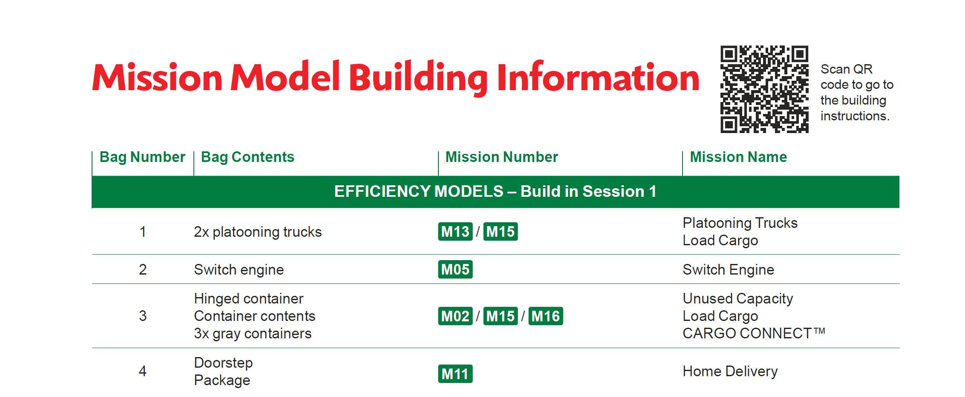
Efficiency Project Spark
Build the Efficiency models in Bags 1-4 using Building Instruction Books 1-4.
Notes:
Facilitator Tips
Provide the digital building instructions Books 1-4 to the team. Find them at firstlegoleague.org/ season#resources.
The team will need Bags 1-4 from the Challenge set. Larger pieces may be in an unnumbered LEGO® bag.
Have the team record their brainstorming ideas as a bulleted list in the Engineering Notebook or in another location.

Slide 10
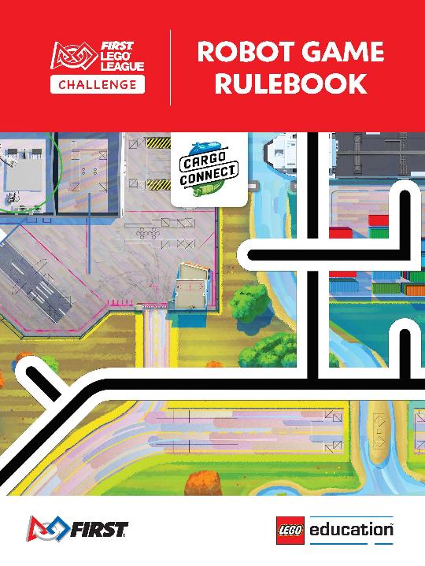
Efficiency Project Spark
Check out the Robot Game Rulebook. This will be a great resource throughout the sessions.
Review the missions that relate to the models you built.
Notes:
Facilitator Tips
Provide the digital building instructions Books 1-4 to the team. Find them at firstlegoleague.org/ season#resources.
The team will need Bags 1-4 from the Challenge set. Larger pieces may be in an unnumbered LEGO® bag.
Have the team record their brainstorming ideas as a bulleted list in the Engineering Notebook or in another location.

Slide 11
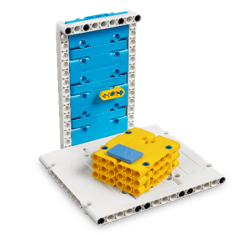
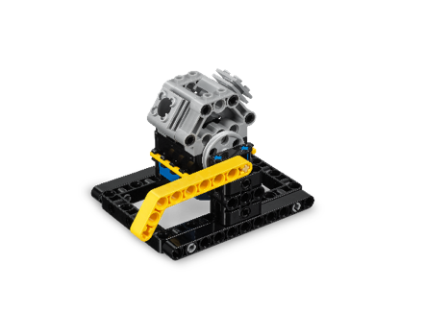
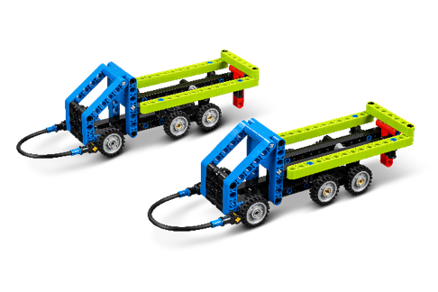
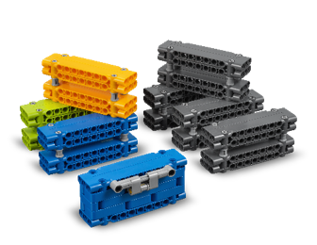
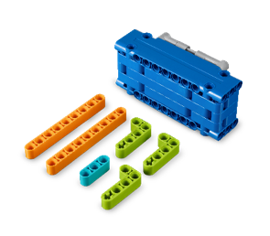
Efficiency Project Spark
Discuss how the mission models are linked to the Project Spark.
Brainstorm and record your ideas that relate to this Project Spark.
Notes:
Facilitator Tips
Provide the digital building instructions Books 1-4 to the team. Find them at firstlegoleague.org/ season#resources.
The team will need Bags 1-4 from the Challenge set. Larger pieces may be in an unnumbered LEGO® bag.
Have the team record their brainstorming ideas as a bulleted list in the Engineering Notebook or in another location.

Slide 12

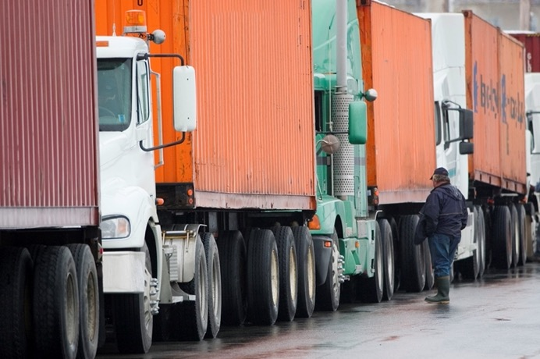
Platooning Trucks
Notes:
Facilitator Tips
Find videos for each mission in the interactive Robot Game Rulebook.

Slide 13

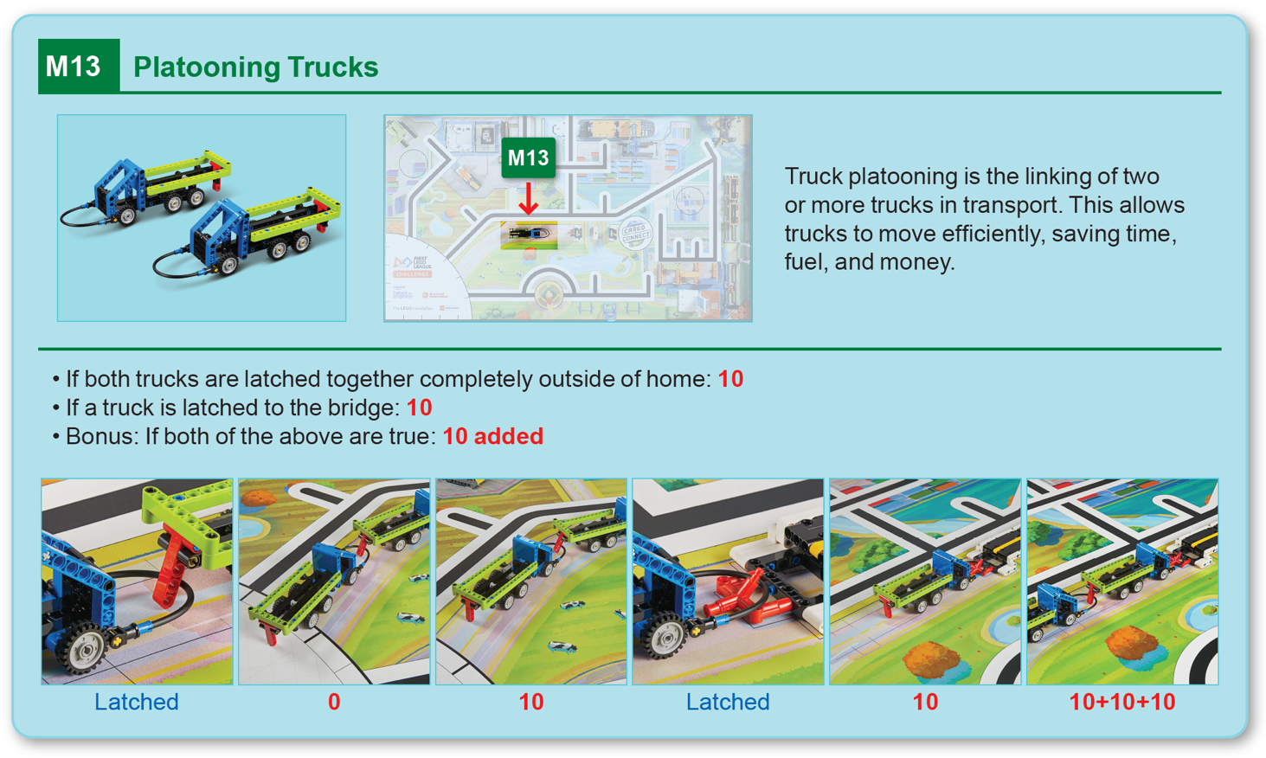
Robot
Game
Rulebook
page 18

Slide 14
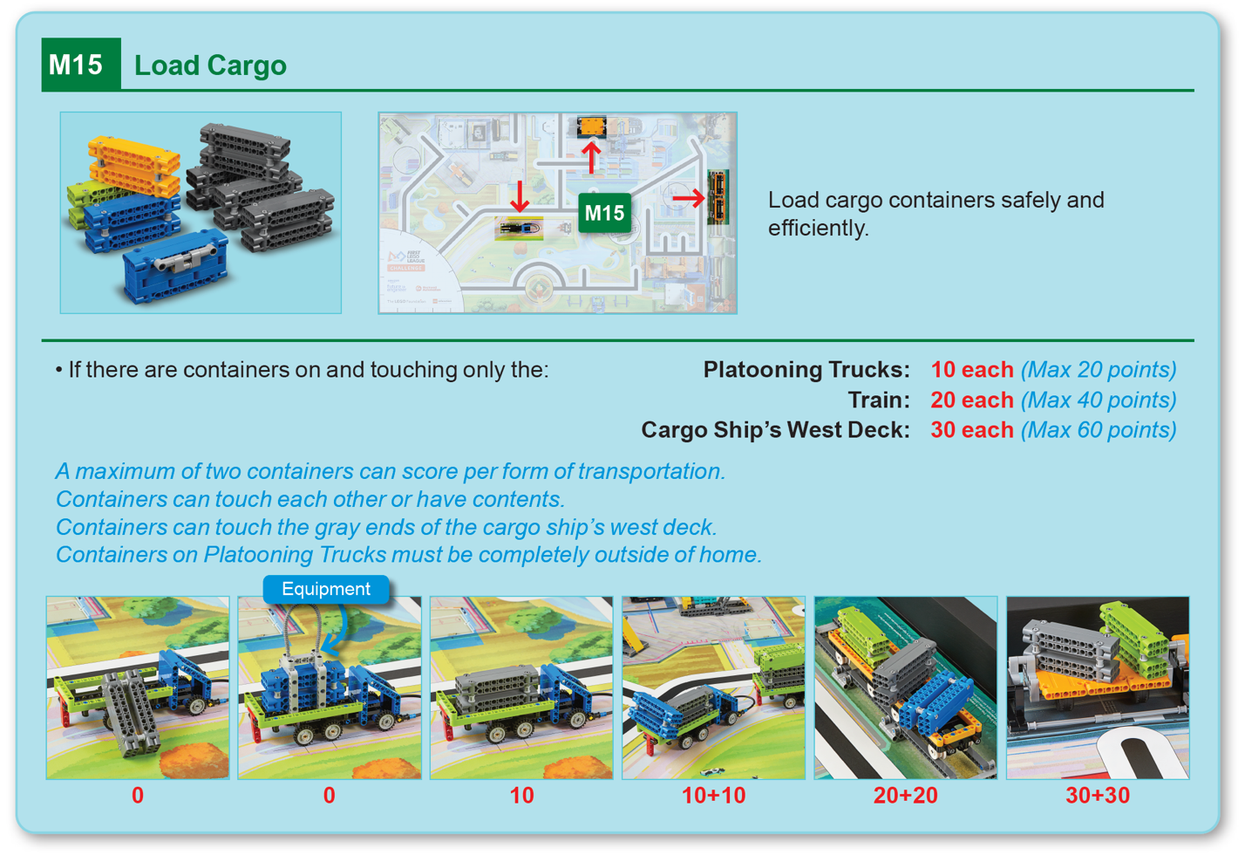
Robot
Game
Rulebook
page 19

Slide 15


Switch Engine
Notes:
Facilitator Tips
Find videos for each mission in the interactive Robot Game Rulebook.

Slide 16
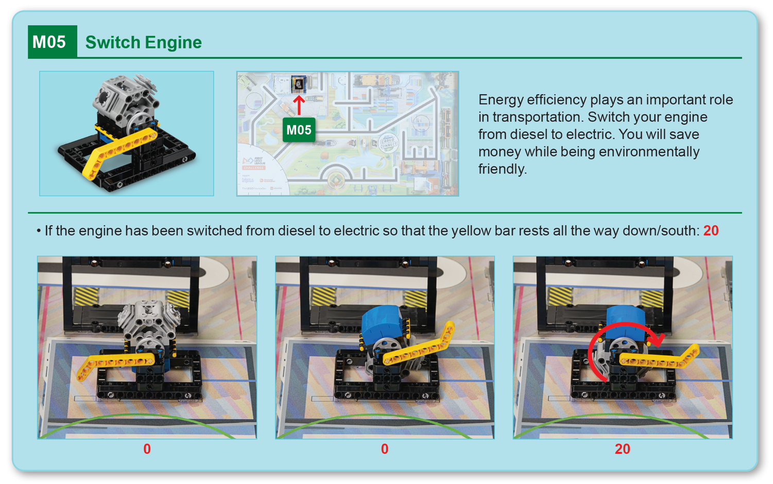
Robot
Game
Rulebook
page 18

Slide 17
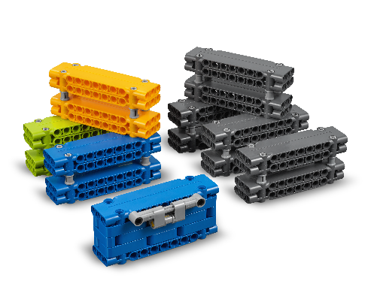

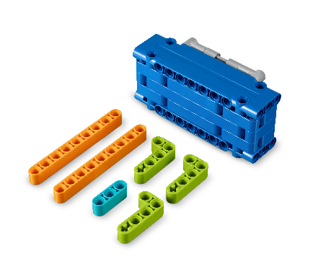
Shipping Containers
Notes:
Facilitator Tips
Find videos for each mission in the interactive Robot Game Rulebook.

Slide 18
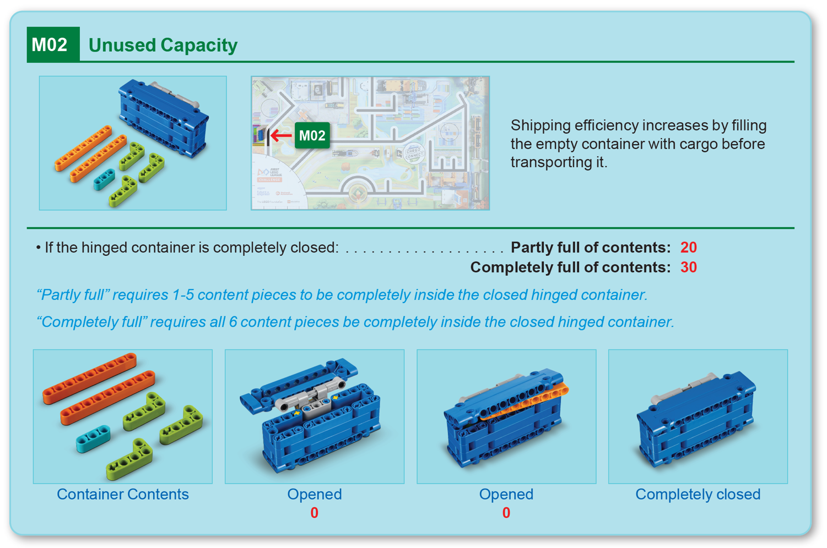
Robot
Game
Rulebook
page 13

Slide 19
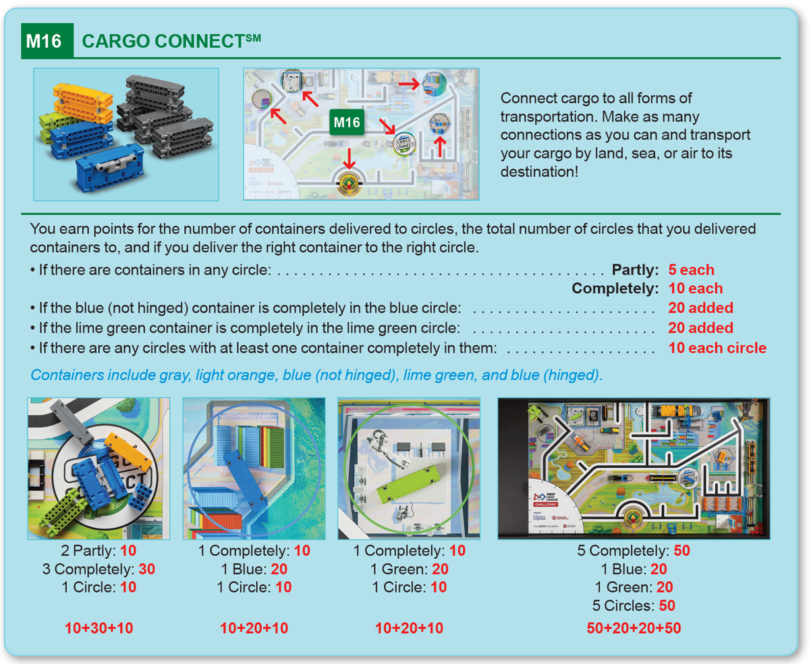
Robot
Game
Rulebook
page 20

Slide 20
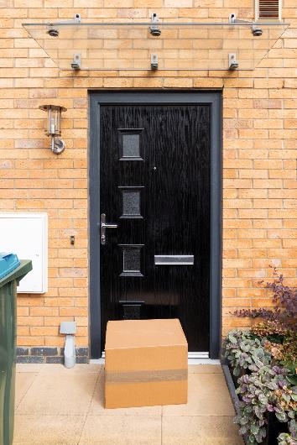

Doorstep Package
Notes:
Facilitator Tips
Find videos for each mission in the interactive Robot Game Rulebook.

Slide 21
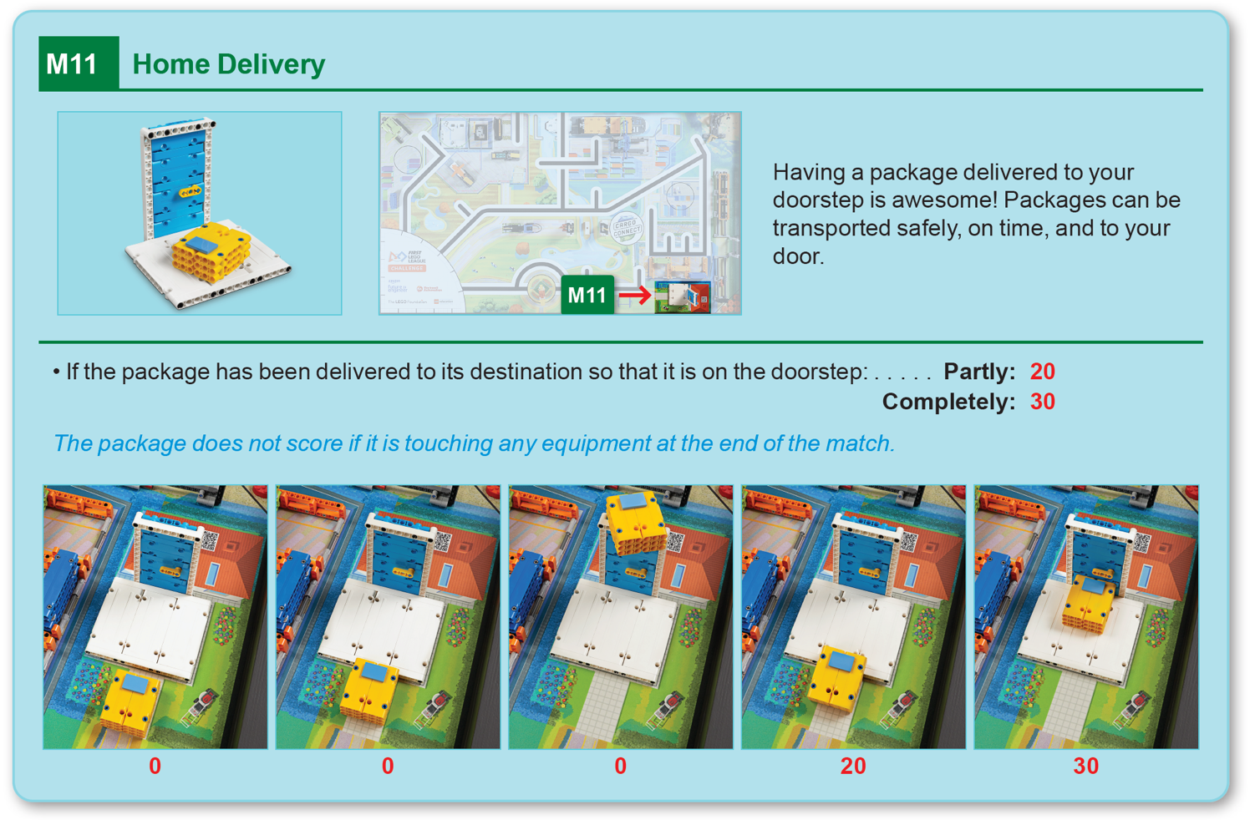
Robot
Game
Rulebook
page 17

Slide 22

Share
Get together at the mat.
Place each model where it belongs. Refer to the Field Setup section in the Robot Game Rulebook.
Show the robot skills you learned.
Show how the models work and explain how they relate to the Project Spark.
Discuss the reflection questions.
Clean up your space.
Notes:
Place the completed models on the mat with Dual Lock™ according to the field setup in the Robot Game Rulebook.

Slide 23
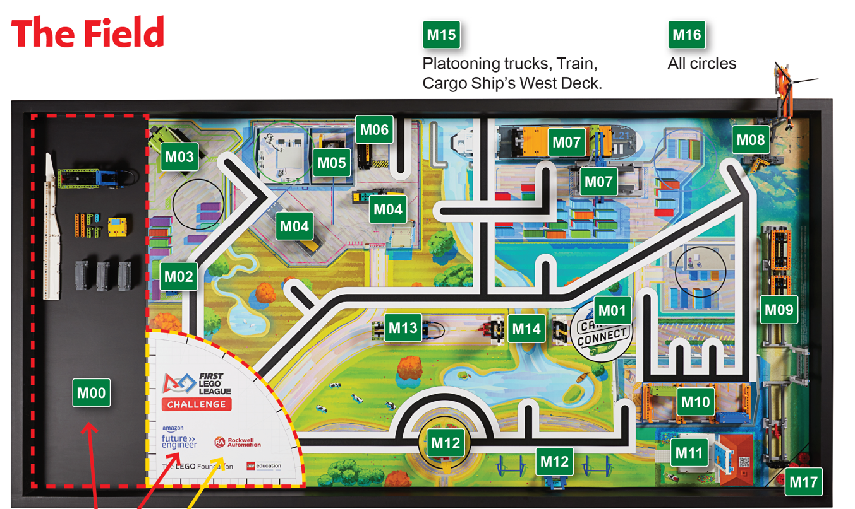
Models built this session are for the circled missions.
Notes:
Place the completed models on the mat with Dual Lock™ according to the field setup in the Robot Game Rulebook.

Slide 24

Reflection Questions
Do any of the mission models make you think of good ideas for the Innovation Project?
What could you create that would improve the efficiency of transporting a particular product?
Notes:
The team can use these Reflection Questions during the Share time. Sharing at the end is an important way for the team to summarize and reflect.

Slide 25

Career Connections
Check out the careers highlighted on pages 34-35 of your Engineering Notebook.

Slide 26

Clean Up
Notes:
Allow time for cleanup and place any unfinished models and their pieces in a sealed plastic bag.

Slide 27

FIRST® and the FIRST® logo are registered trademarks of For Inspiration and Recognition of Science and Technology (FIRST). LEGO® and MINDSTORMS® are registered trademarks of the LEGO Group. FIRST® LEGO® League and CARGO CONNECTSM are jointly held trademarks of FIRST and the LEGO Group. SPIKE™ Prime is a trademark of LEGO® Education. All other trademarks are the property of their respective owners. ©2021 FIRST and the LEGO Group. All rights reserved.

